Slide 1
Pabby Connect Webhook URL
For EDM Automation

Slide 2
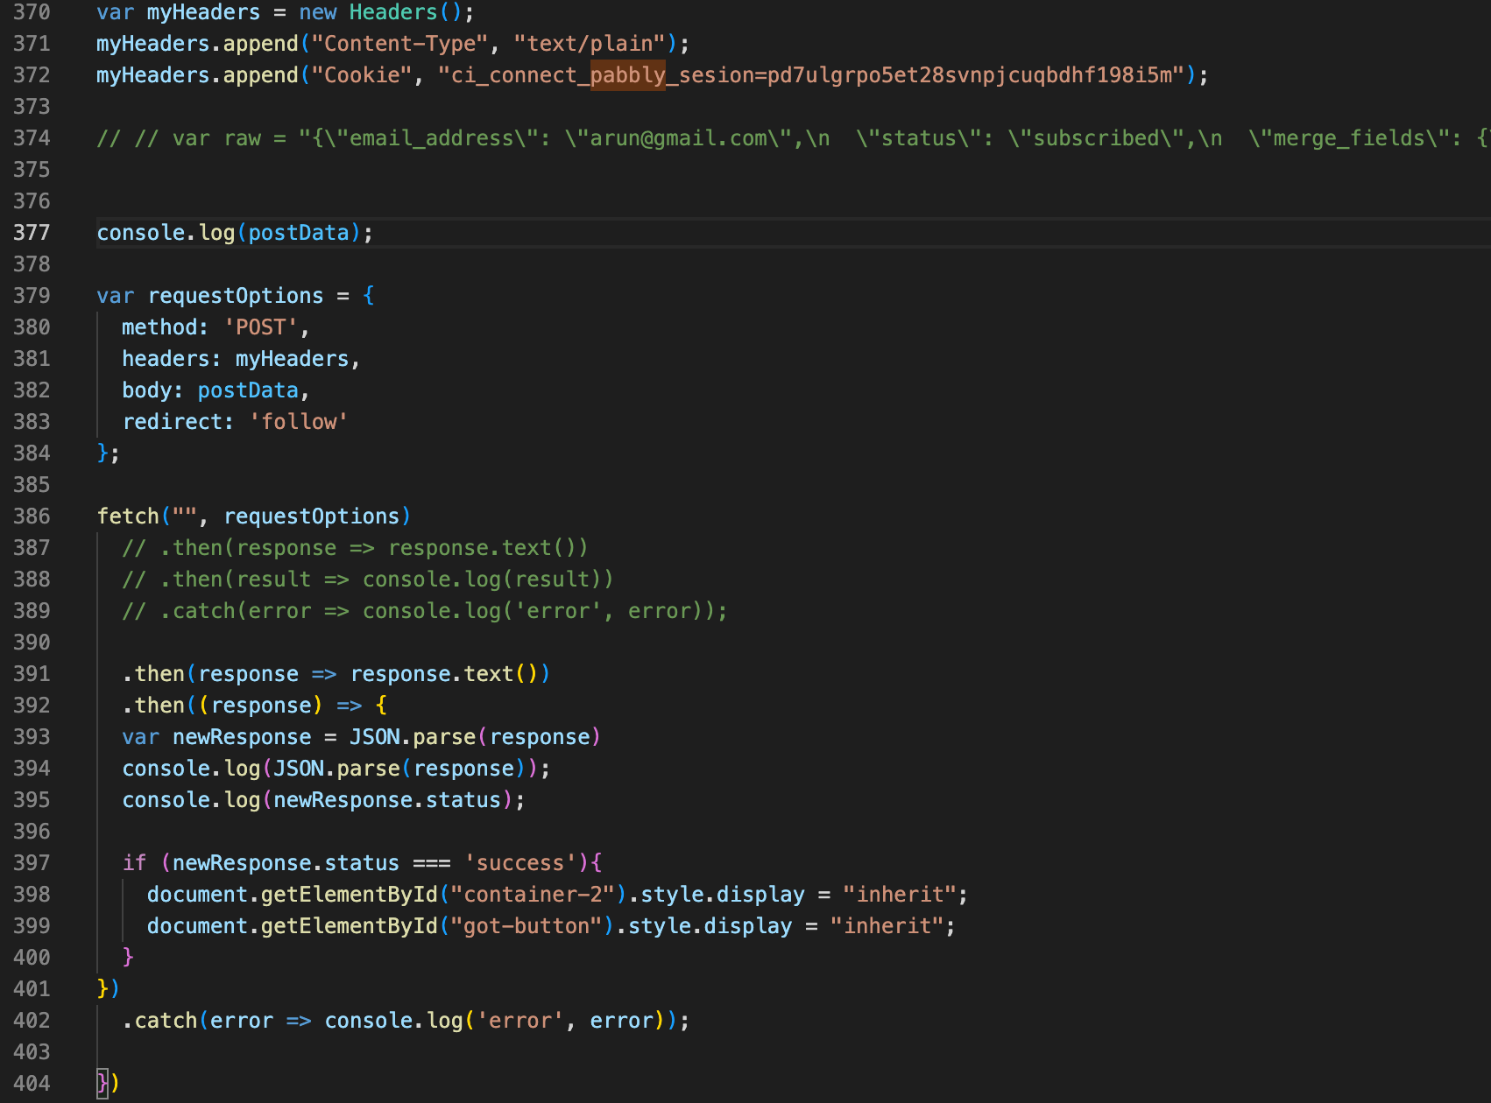
4. Paste the Webhook URL here
5. Suggest hiding the API Key

Slide 3
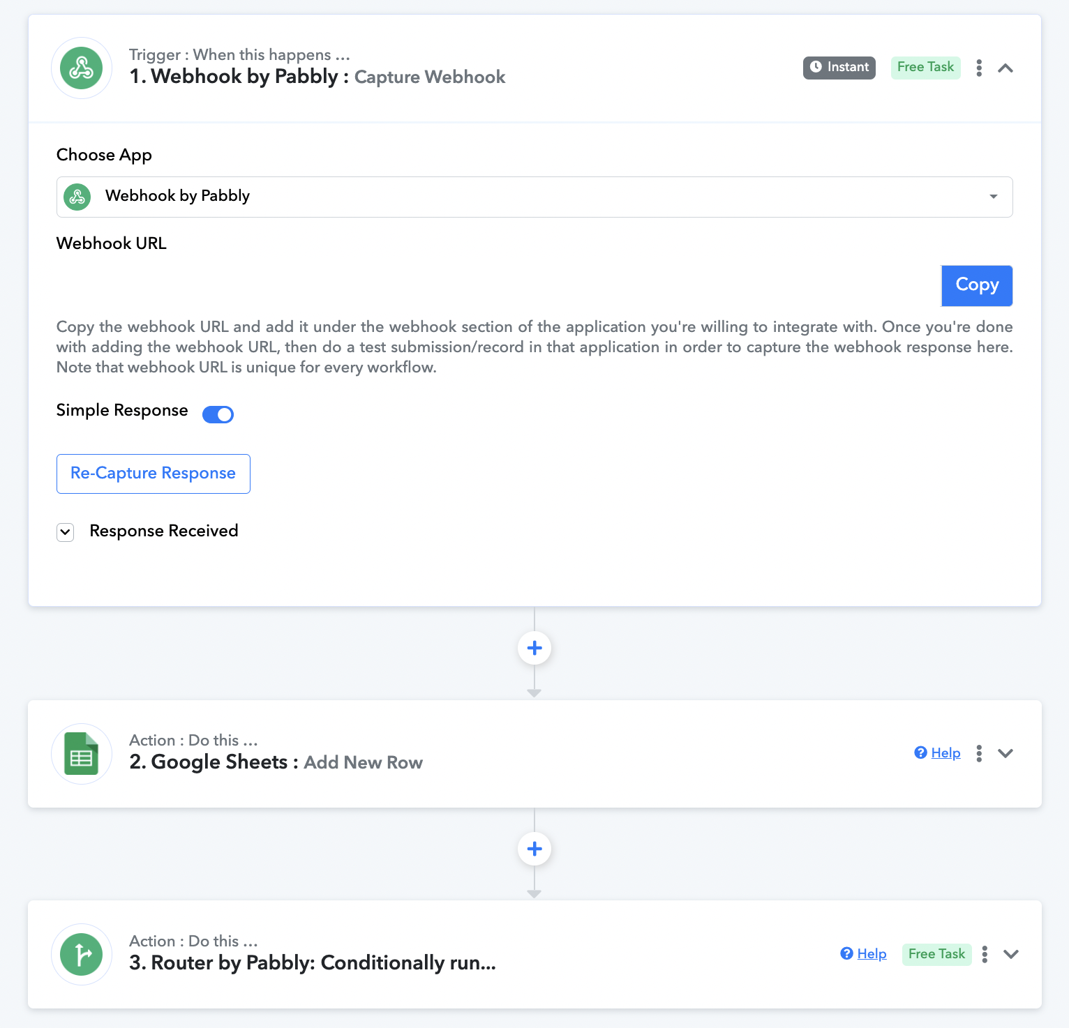
Create an account on Pabbly Connect and create your own workflow
Follow the guide on their website
Copy the Webhook URL
Upgrade the payment plan according to their your usage

Slide 4
Face Plus Plus API
Skin Analysis
(refer here for documentation)

Slide 5
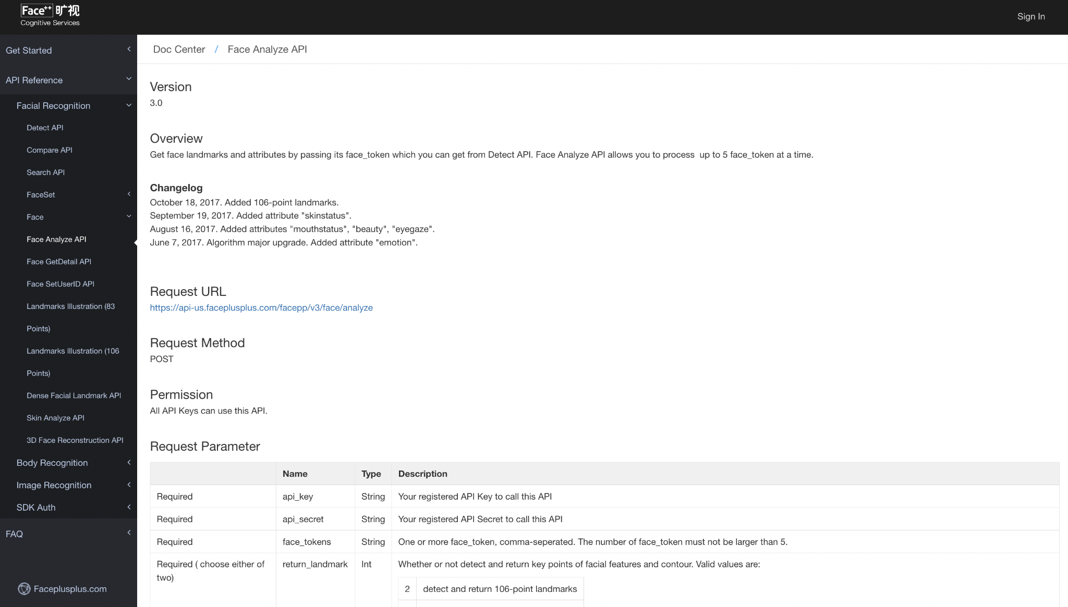

Slide 6
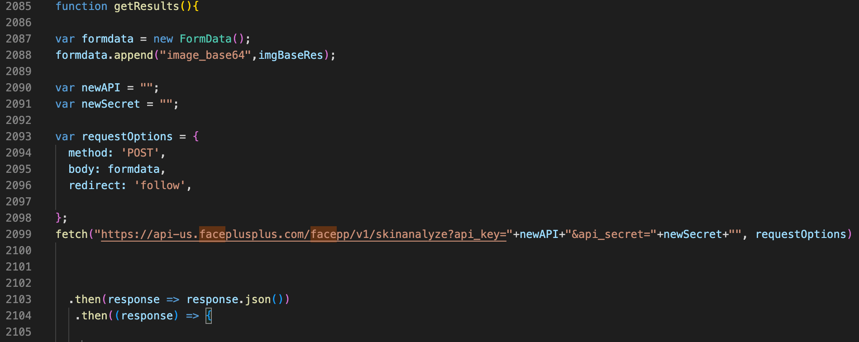
Sign up to generate the API Key & API Secret
Copy the keys’ values
Paste it in scanning.html file
Suggest hiding the API Key in the code
For payment plan, follow their steps to top up the scans

